Slide 1



Experience report - AIAS Bologna

Slide 2
UCM Team @ Bologna
Débora Álvarez
Juan Pavón
Marlon Cárdenas
Carlos Cervigón

Slide 3
Motivation
Using the computer based simulation reducing the expenses by reproducing the AAL environment in a computer simulation
This computer simulation is what we call Virtual Living Lab

Slide 4
Summary
Introductory Meetings with representatives from AIAS
Visiting Smart homes and outdoors (Ausilioteca, Corte Roncati)
Designing virtual versión of the Smart appartment (ground floor) and outdoors
Tasks to be completed
Identifying the most important and relevant use cases, characters and behaviours
Using AIDE tool to simulate a virtual lab based on ground floor appartment and outdoors
Other activities: Visiting AIAS centers

Slide 5
Introductory Meetings with representatives from AIAS.
Massimiliano Malavasi
Valentina Fiordemondo
Evert-Jan Hoogerwerf
Carlo Montanari
Lorenzo Desideri
Lisa Cesario
¡Thank you for all the information!

Slide 6
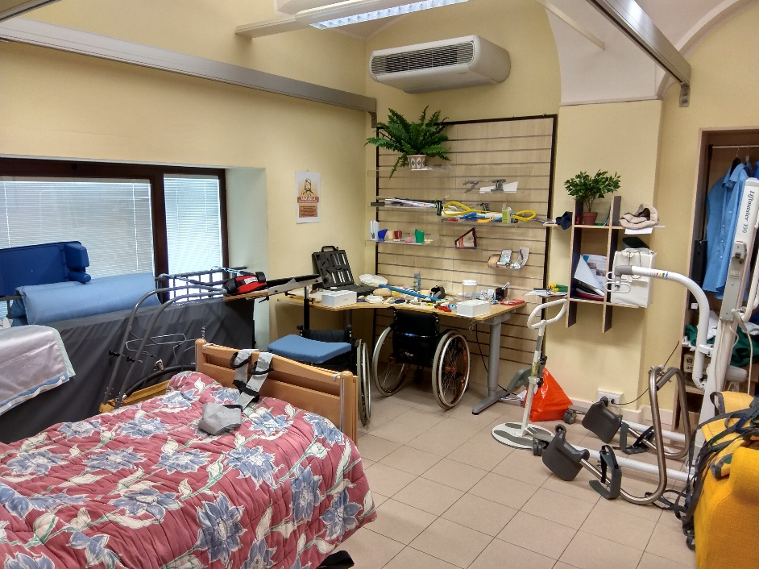
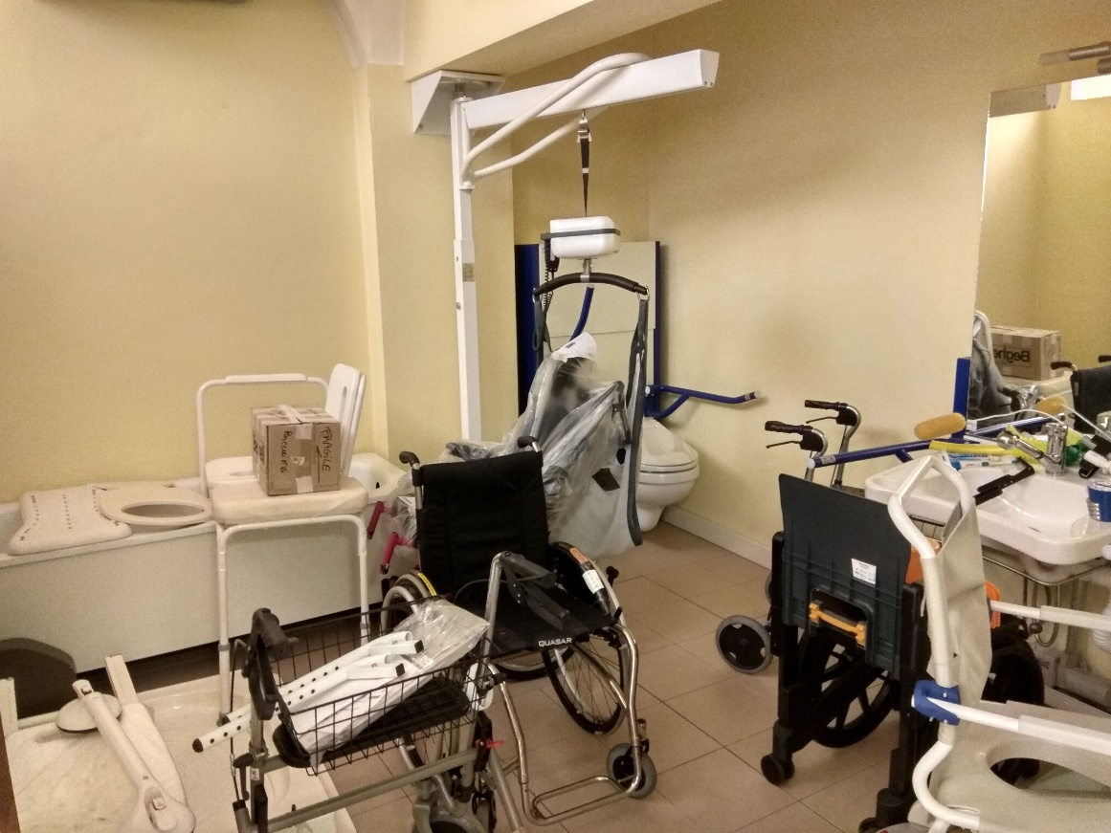
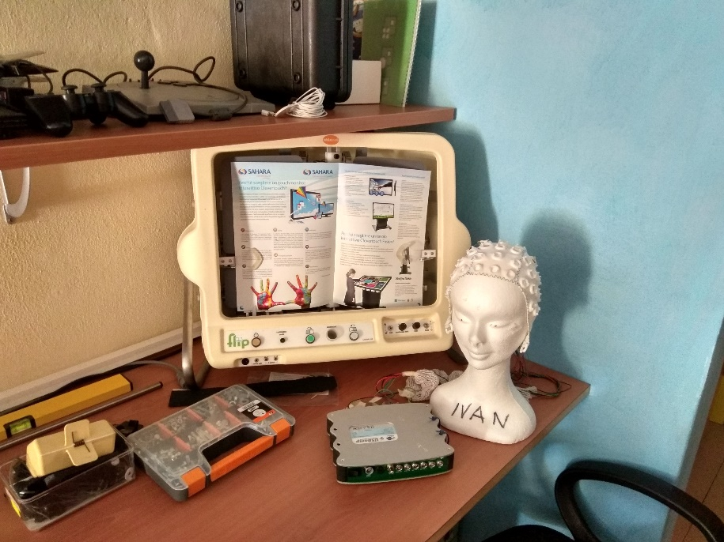
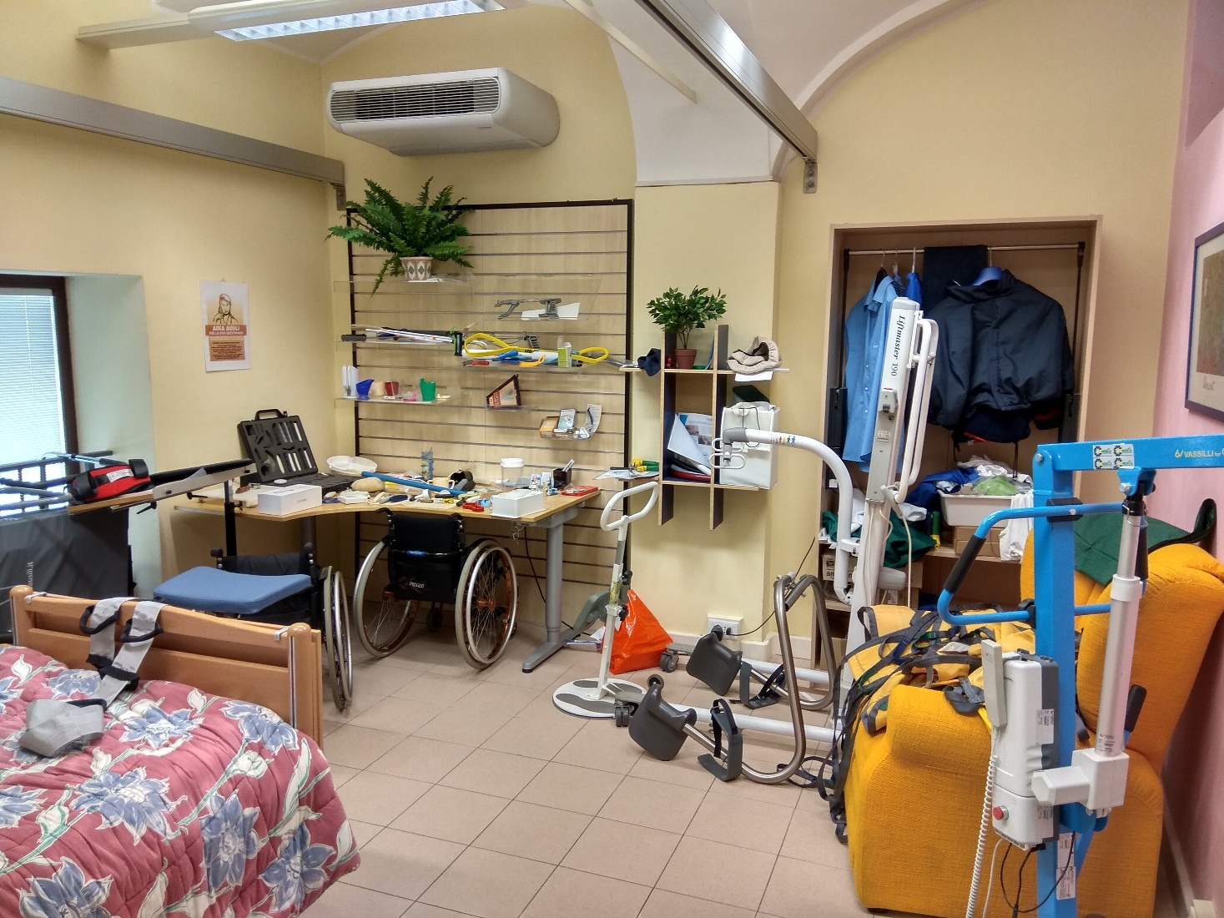
Ausilioteca guided tour
Notes:
knowing the facilities of the ausiloteca and what are you doing

Slide 7
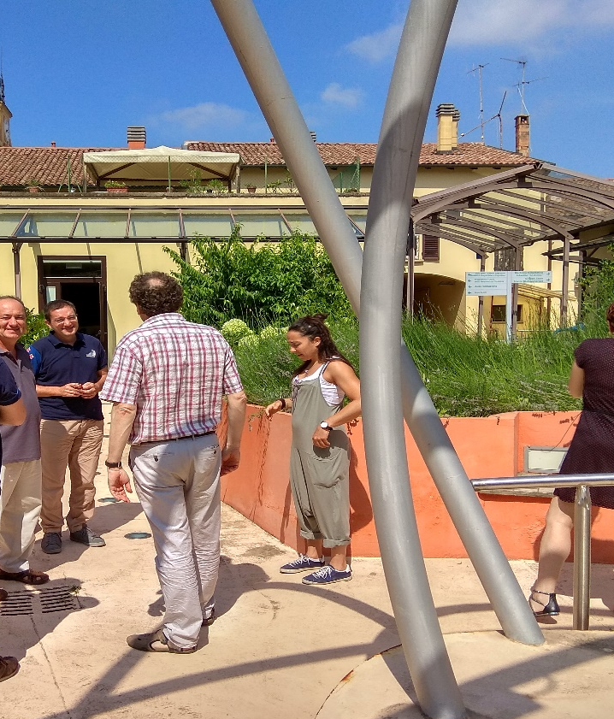
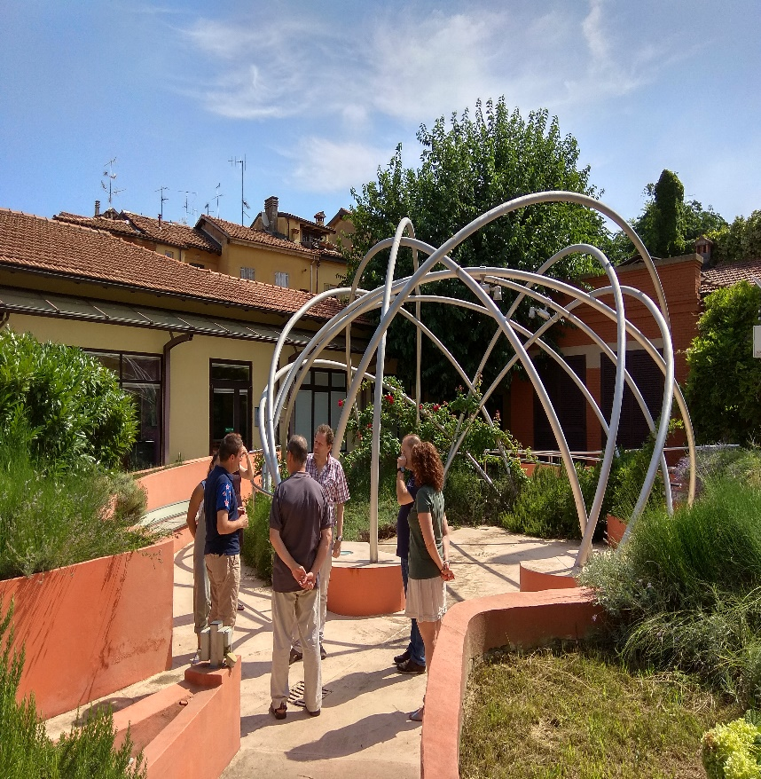
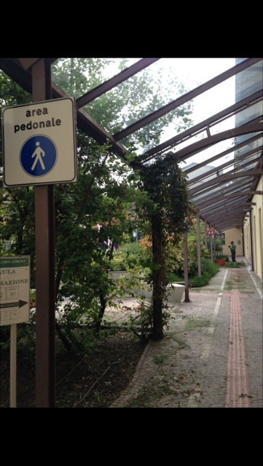
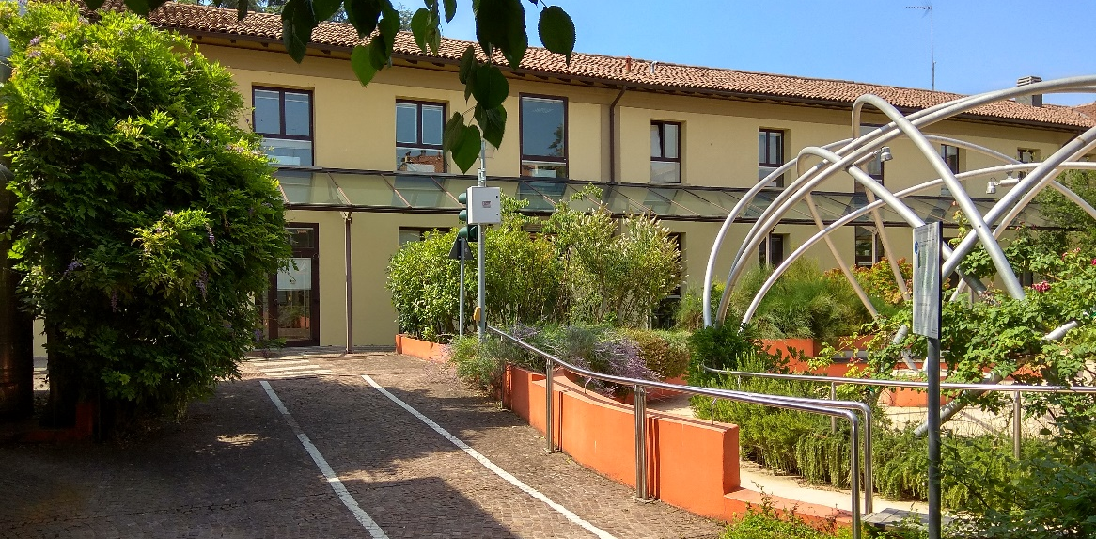
Ausilioteca Outdoors

Slide 8
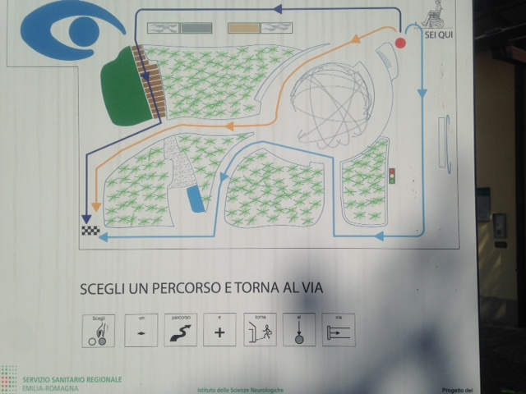
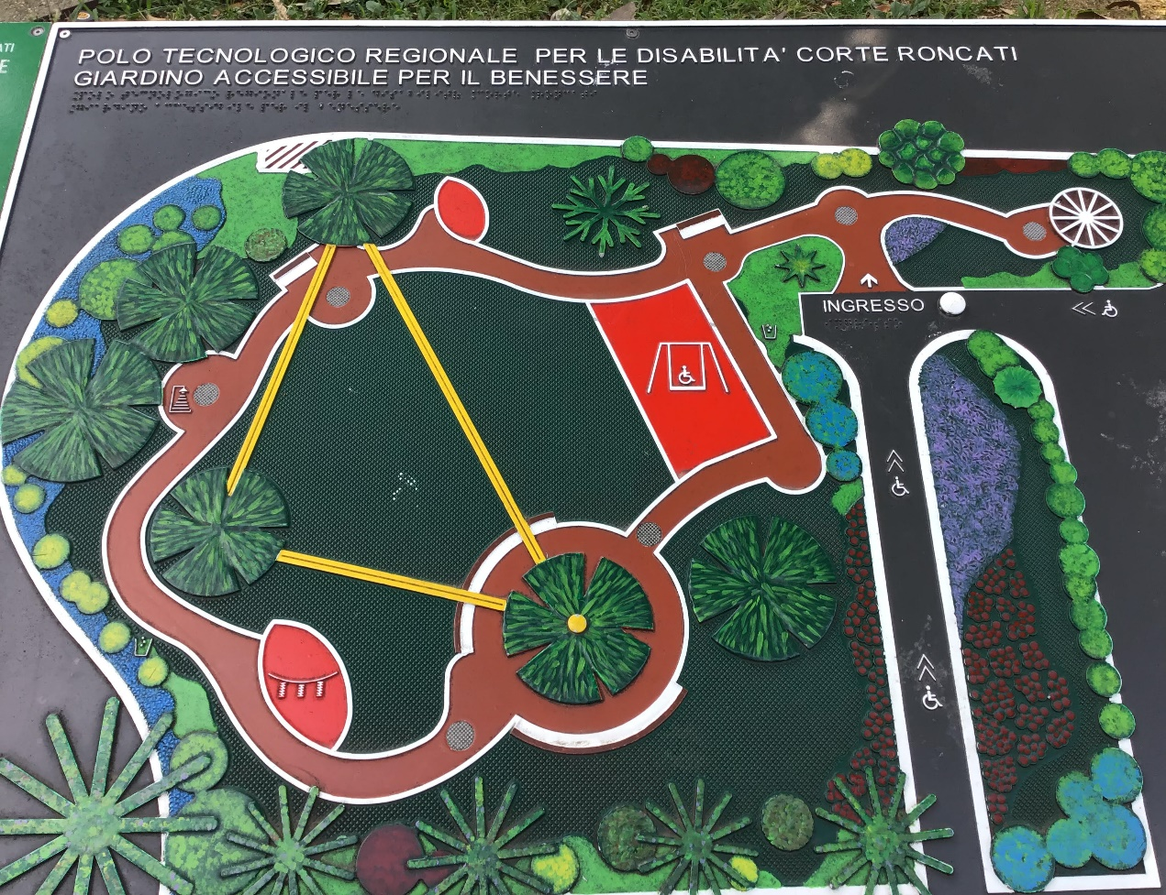
outdoors

Slide 9
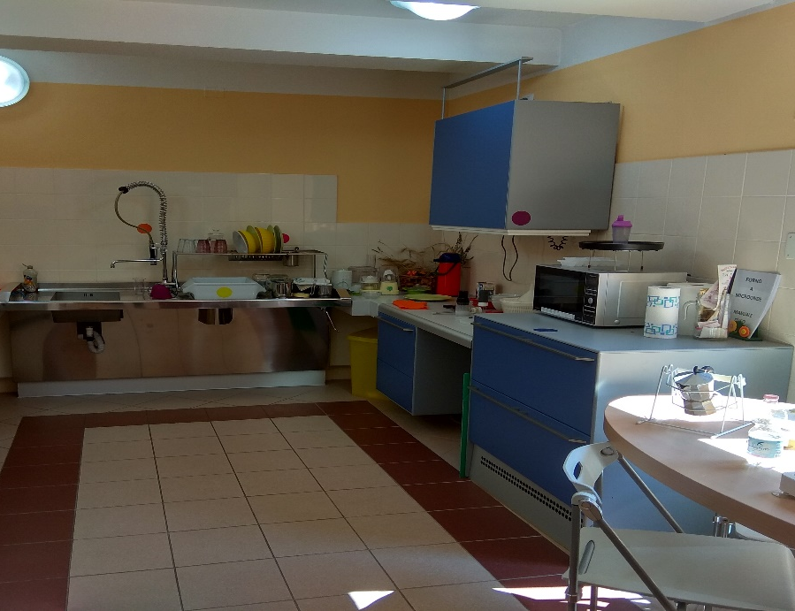
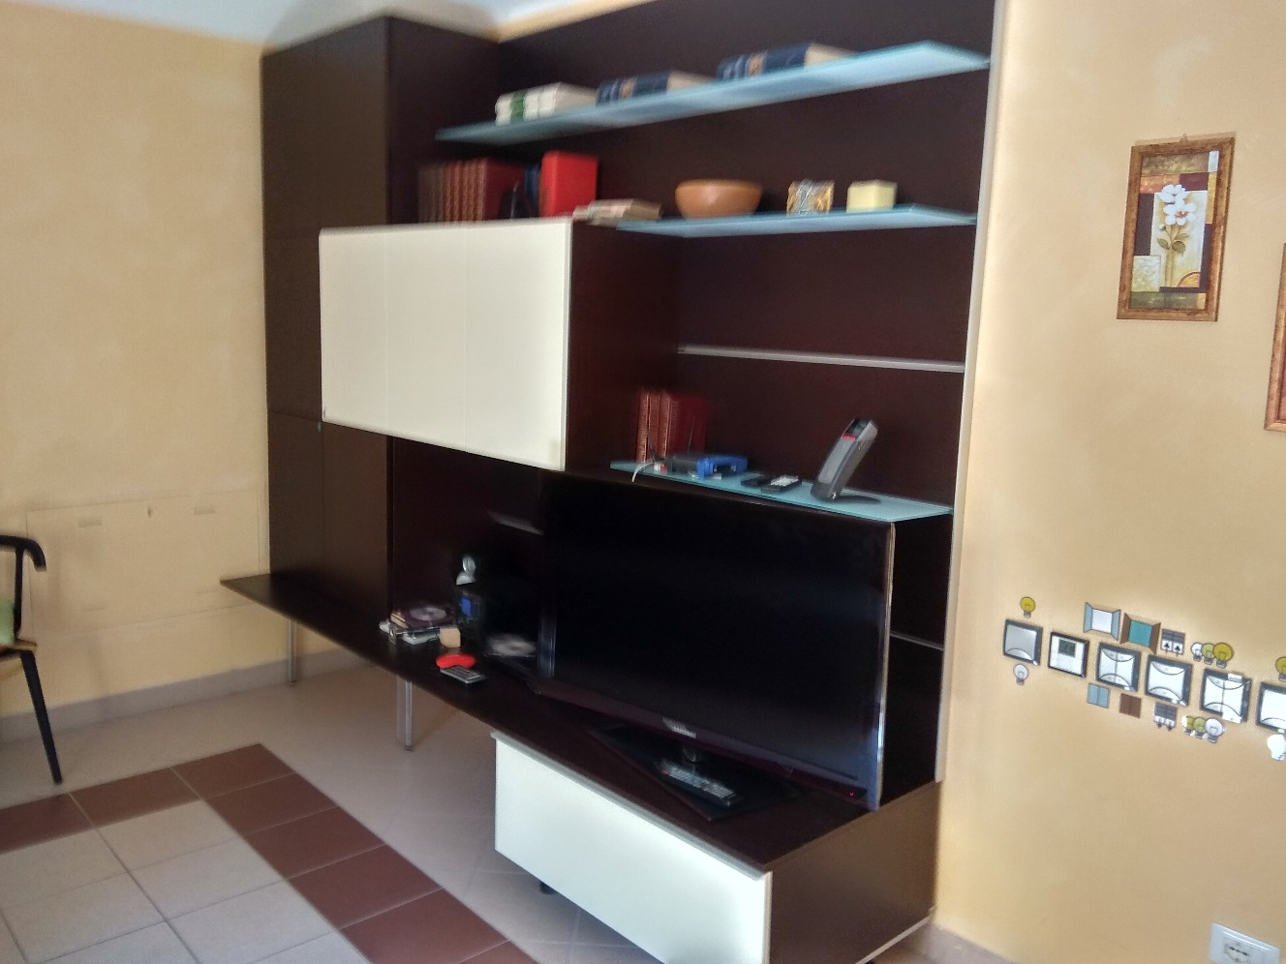
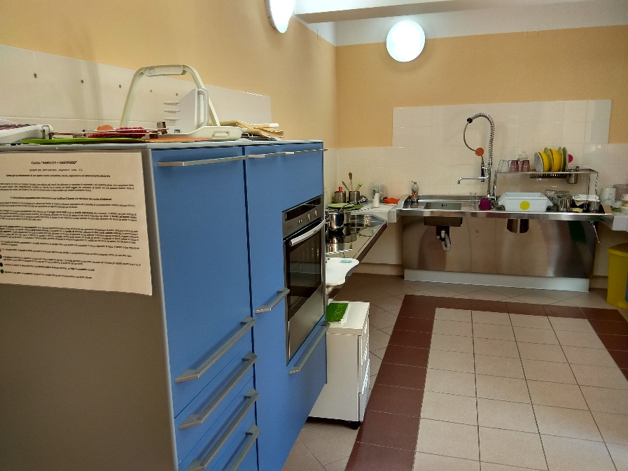
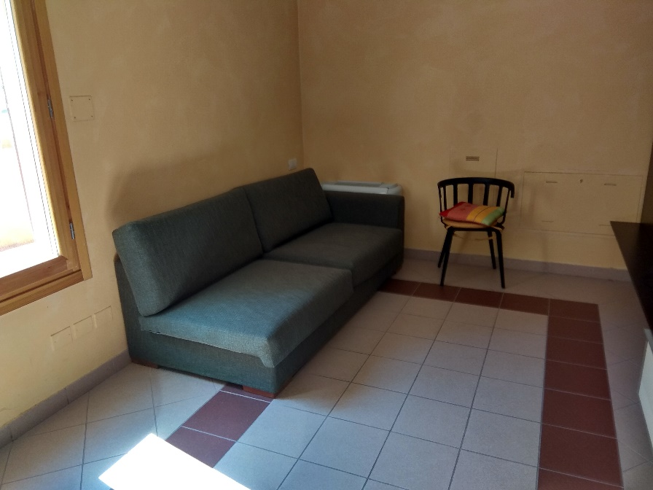
Smart Apartment: ground floor

Slide 10
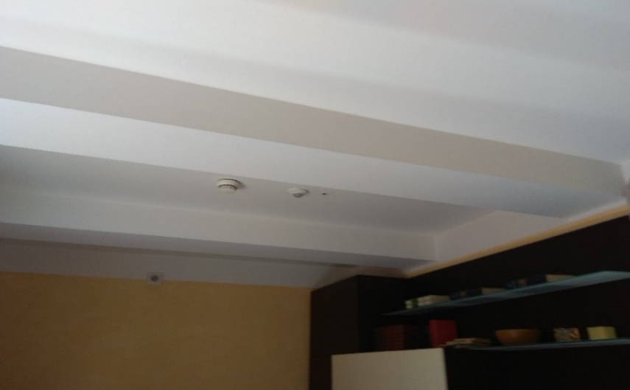
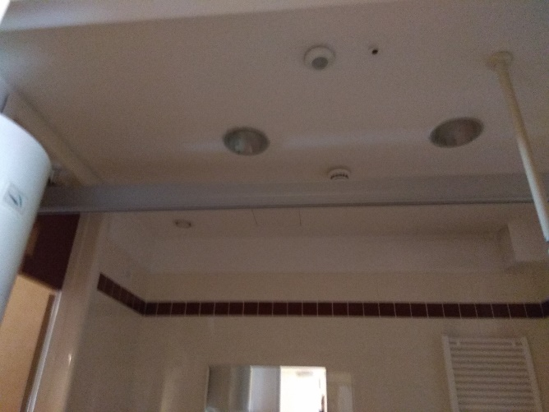
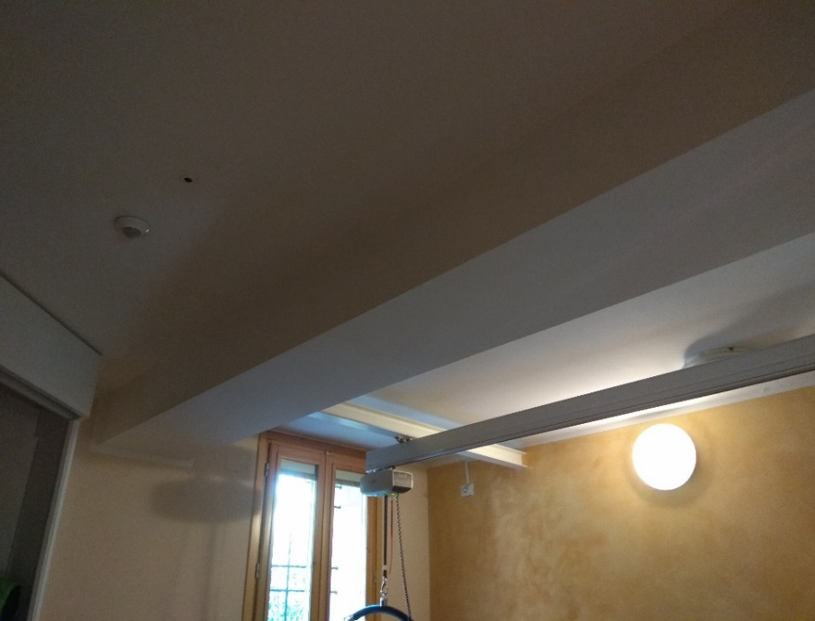
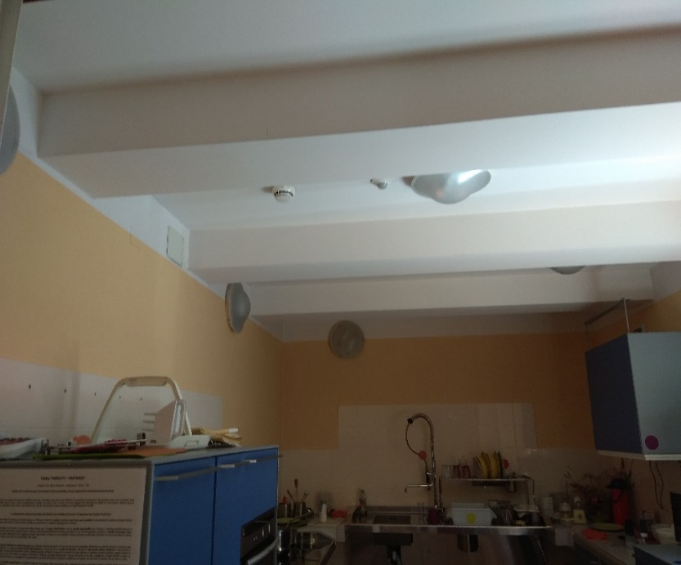
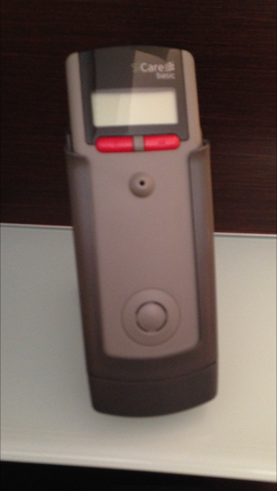
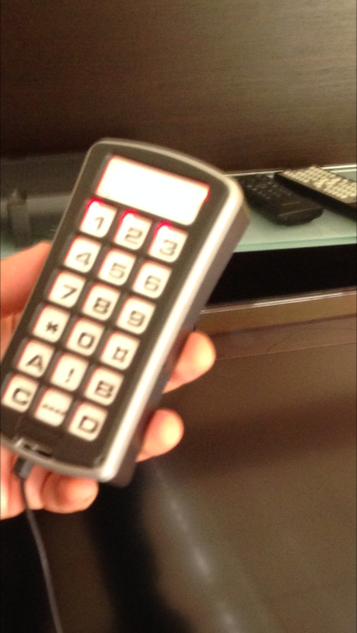
Appartment sensors
Smart Apartment: Sensors and devices

Slide 11
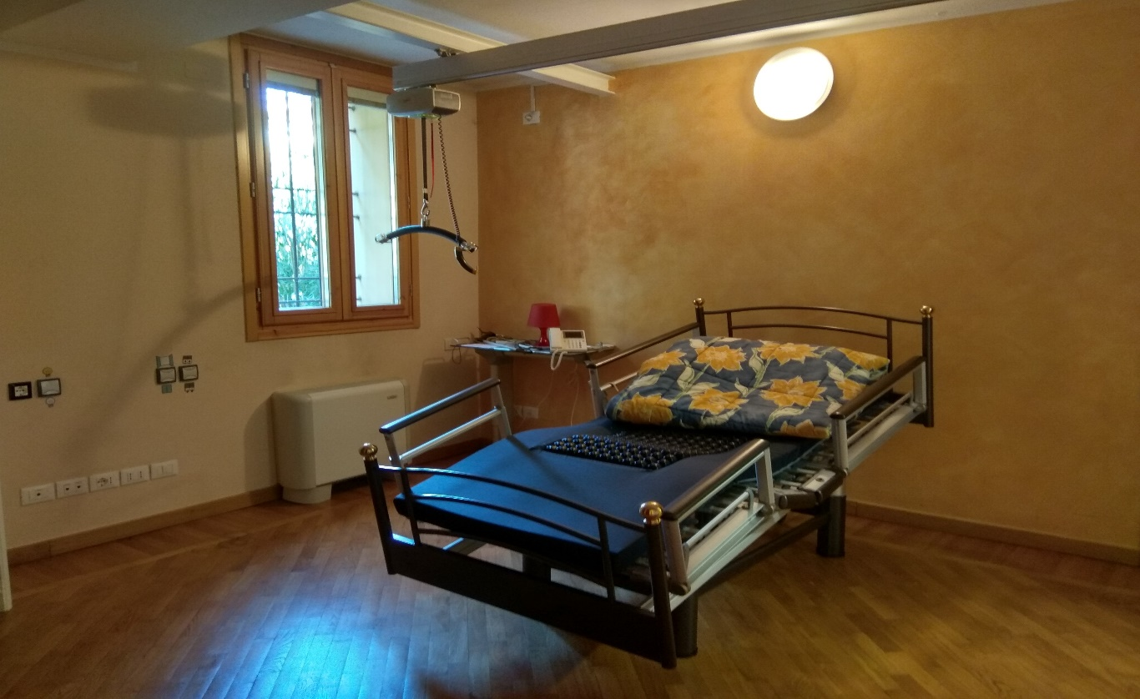
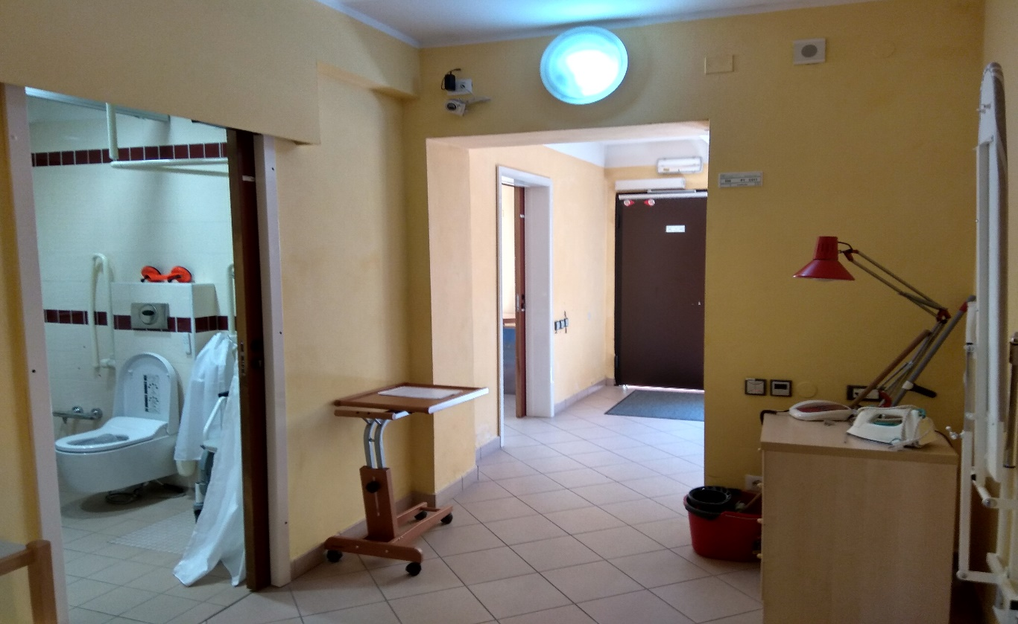
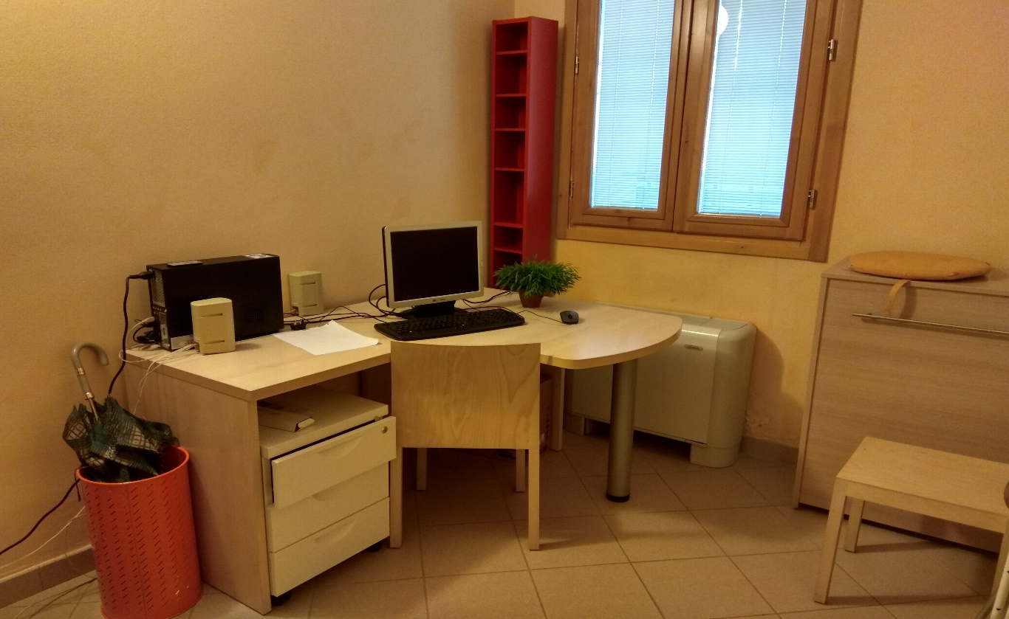
Smart apartment: other rooms

Slide 12
Tasks performed
Designing the maps and plans of the ground floor of the smart apartment and the outdoor area and its corridors. Tool used is Sweet Home 3D
Creating multiple videos with virtual tours of the ground floor apartment and the outdoor area: for training, demos, etc..
Analyse, inventory and design the most relevant objects inside the smart homes: furnitures: controllers, sensors, devices, automatisms, presence sensors, pressure sensors, doors and windows operators, voice recognition devices, etc....
Not included in the design. Can be added later for simulations

Slide 13
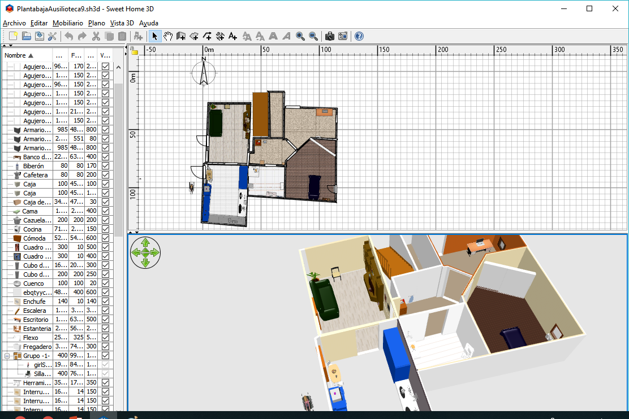
Ground floor in Sweet home 3D:
Map of the appartment
Objects in the appartment
Aerial view

Slide 14
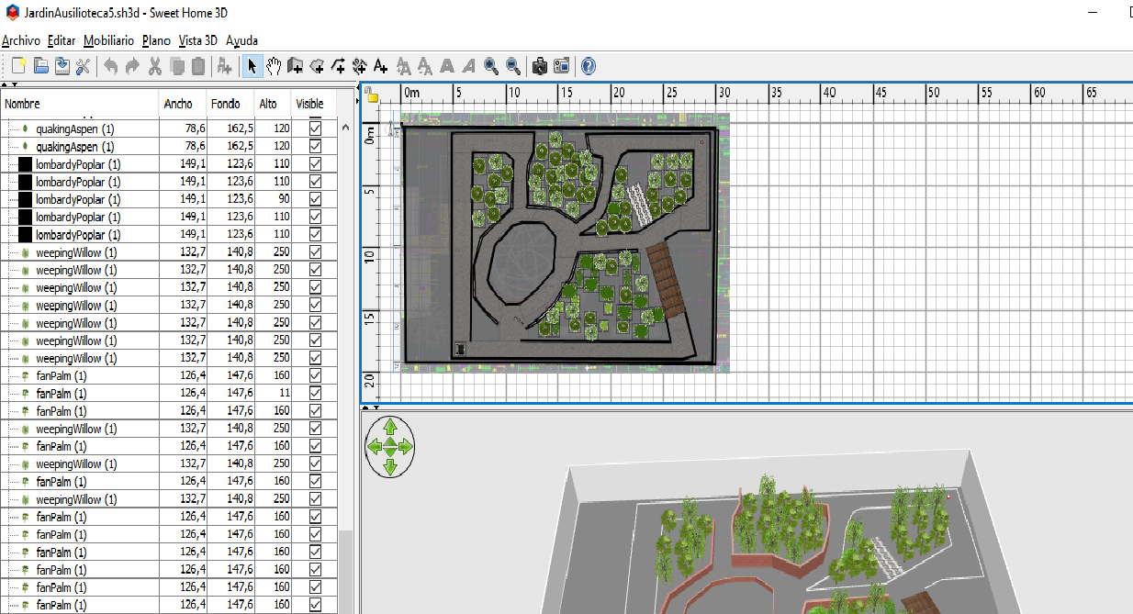
Outdoor in Sweet home 3D:
Map of the outdoors
Objects
Aerial view

Slide 15
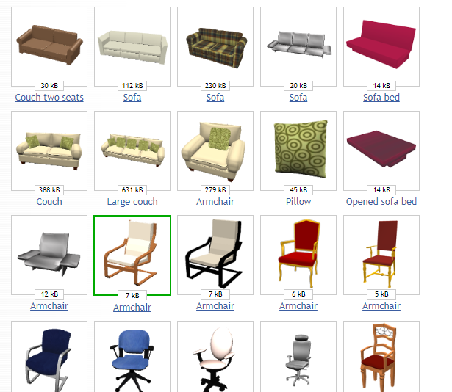
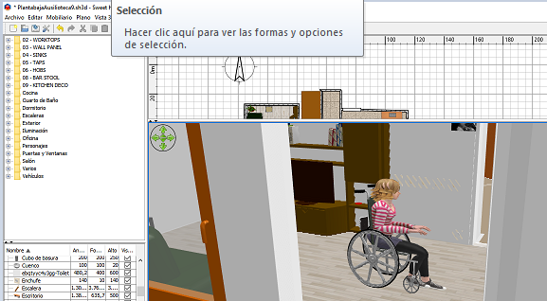
Characters and objects
Predefined
Modified

Slide 16
http://grasiagroup.fdi.ucm.es/aias/

Slide 17
Other tasks
Modeling with AIDE: Marlon…
Identifying individual and contextual relevant variables in accessible housing: Debora

Slide 18
Tasks to be completed
Contribute to the writing and revision of deliverable D1.4. (Analysis of barriers).
Preparation of edition of deliverable D2.1 (Methods for Integration and Empowerment).
Improve the description of the Welcome Kit for Bologna.

Slide 19
Other activities
Visit to other centres:
Centro Socio Riabilitativo Residenziale Selleri Battaglia
Co-housing L’OASI

Slide 20
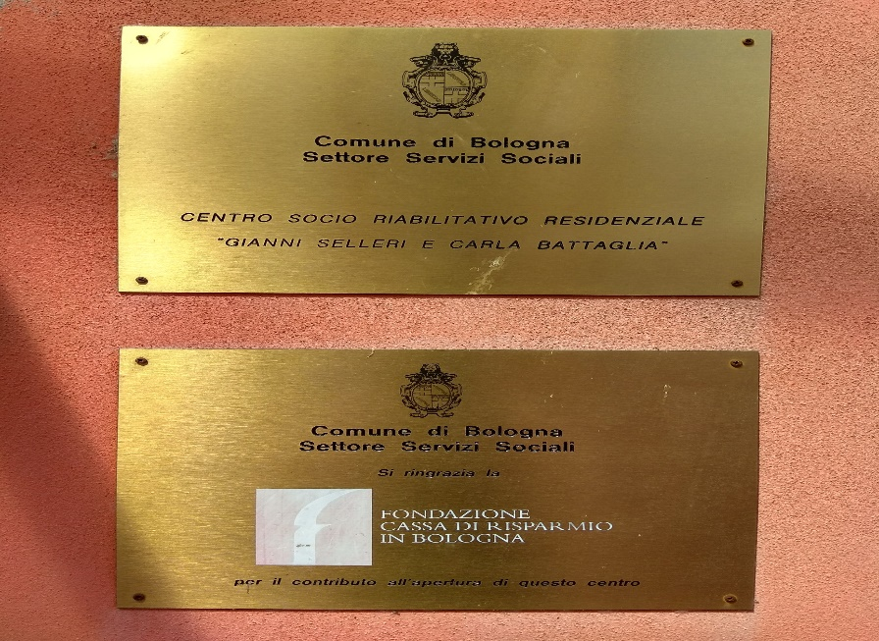
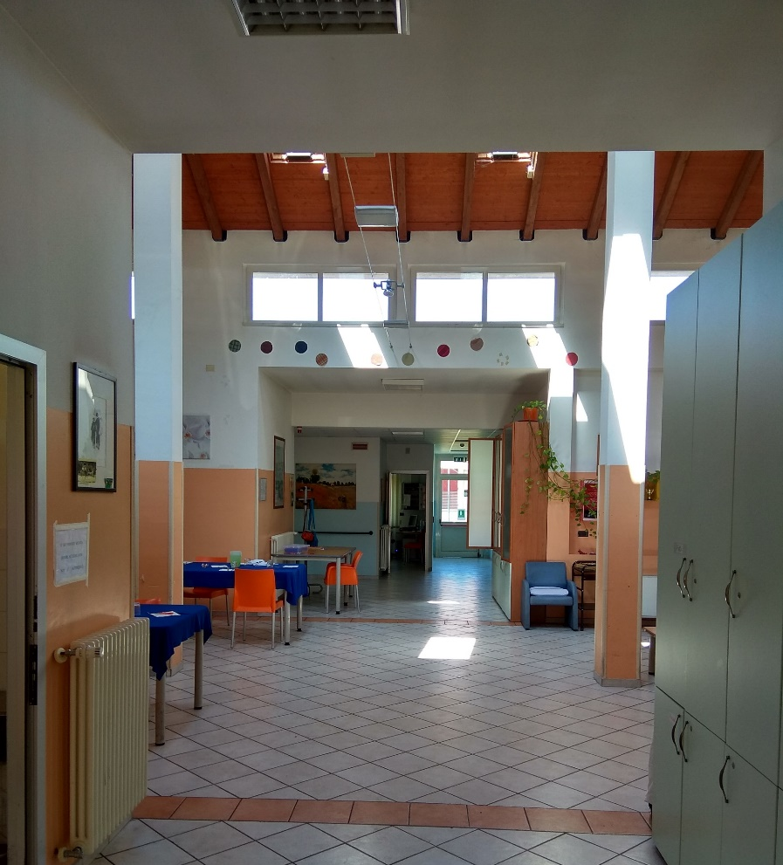
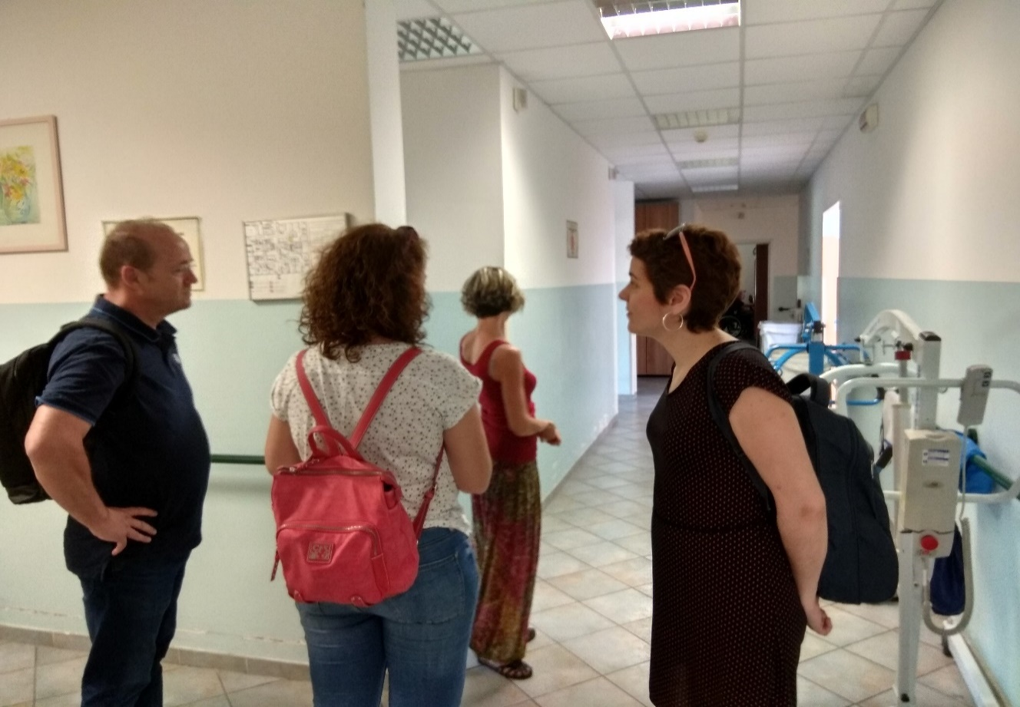
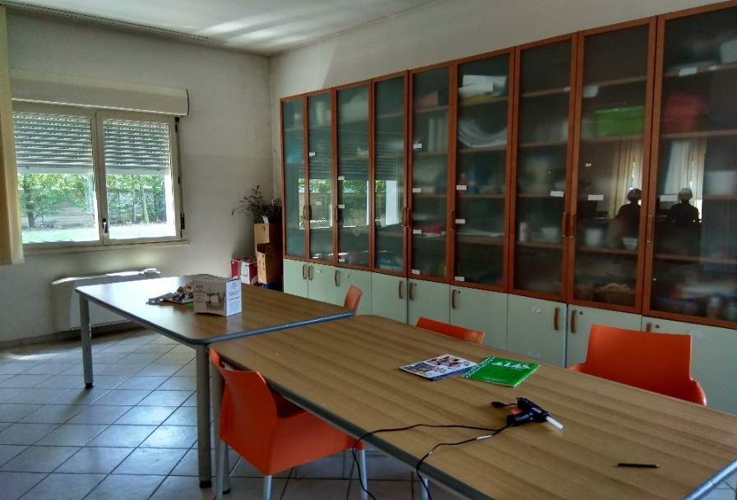
Visiting the center Selleri Battaglia 27-7-2018

Slide 21
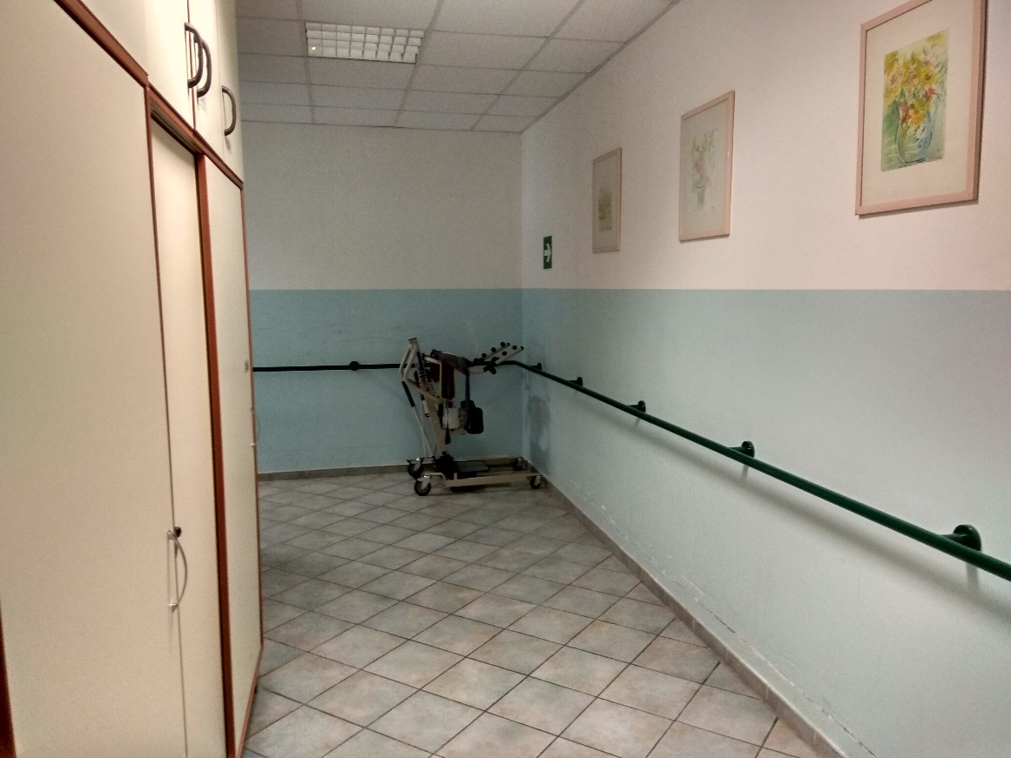
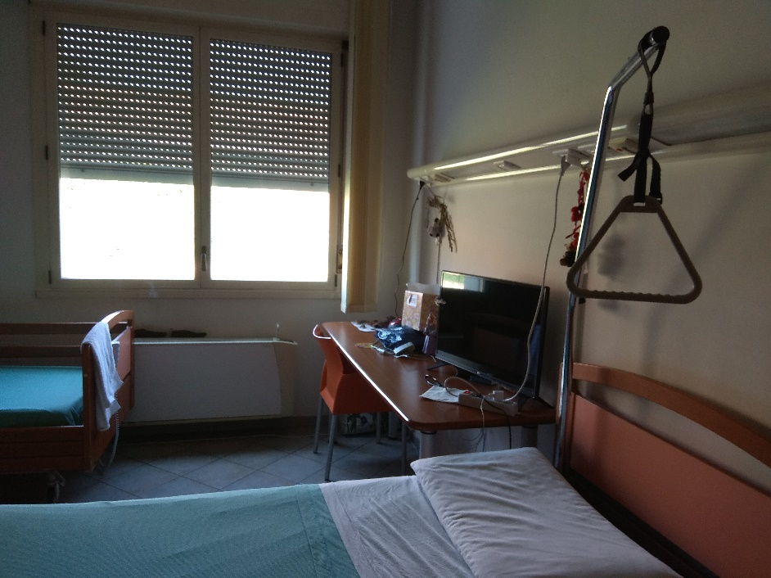
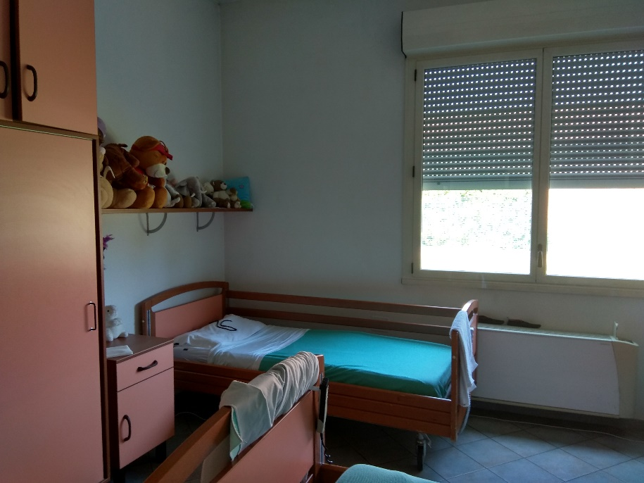
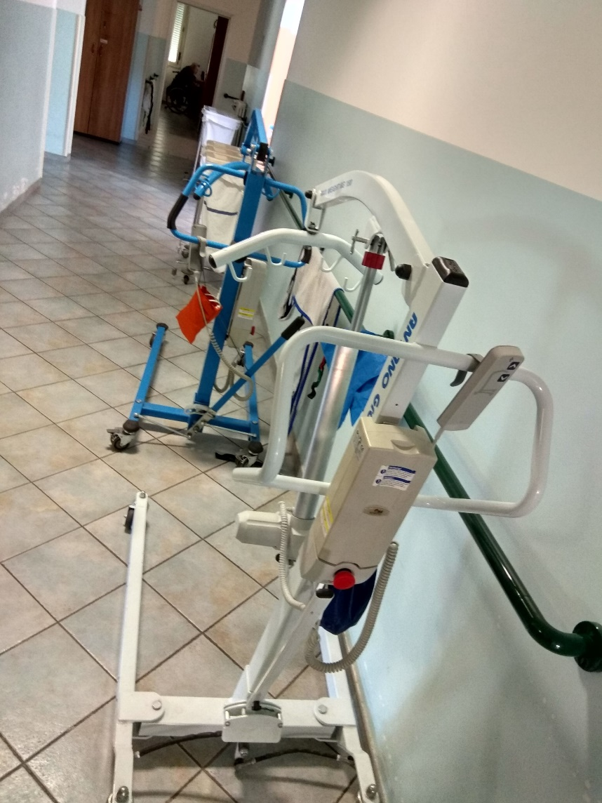
Rooms and corridors

Slide 22
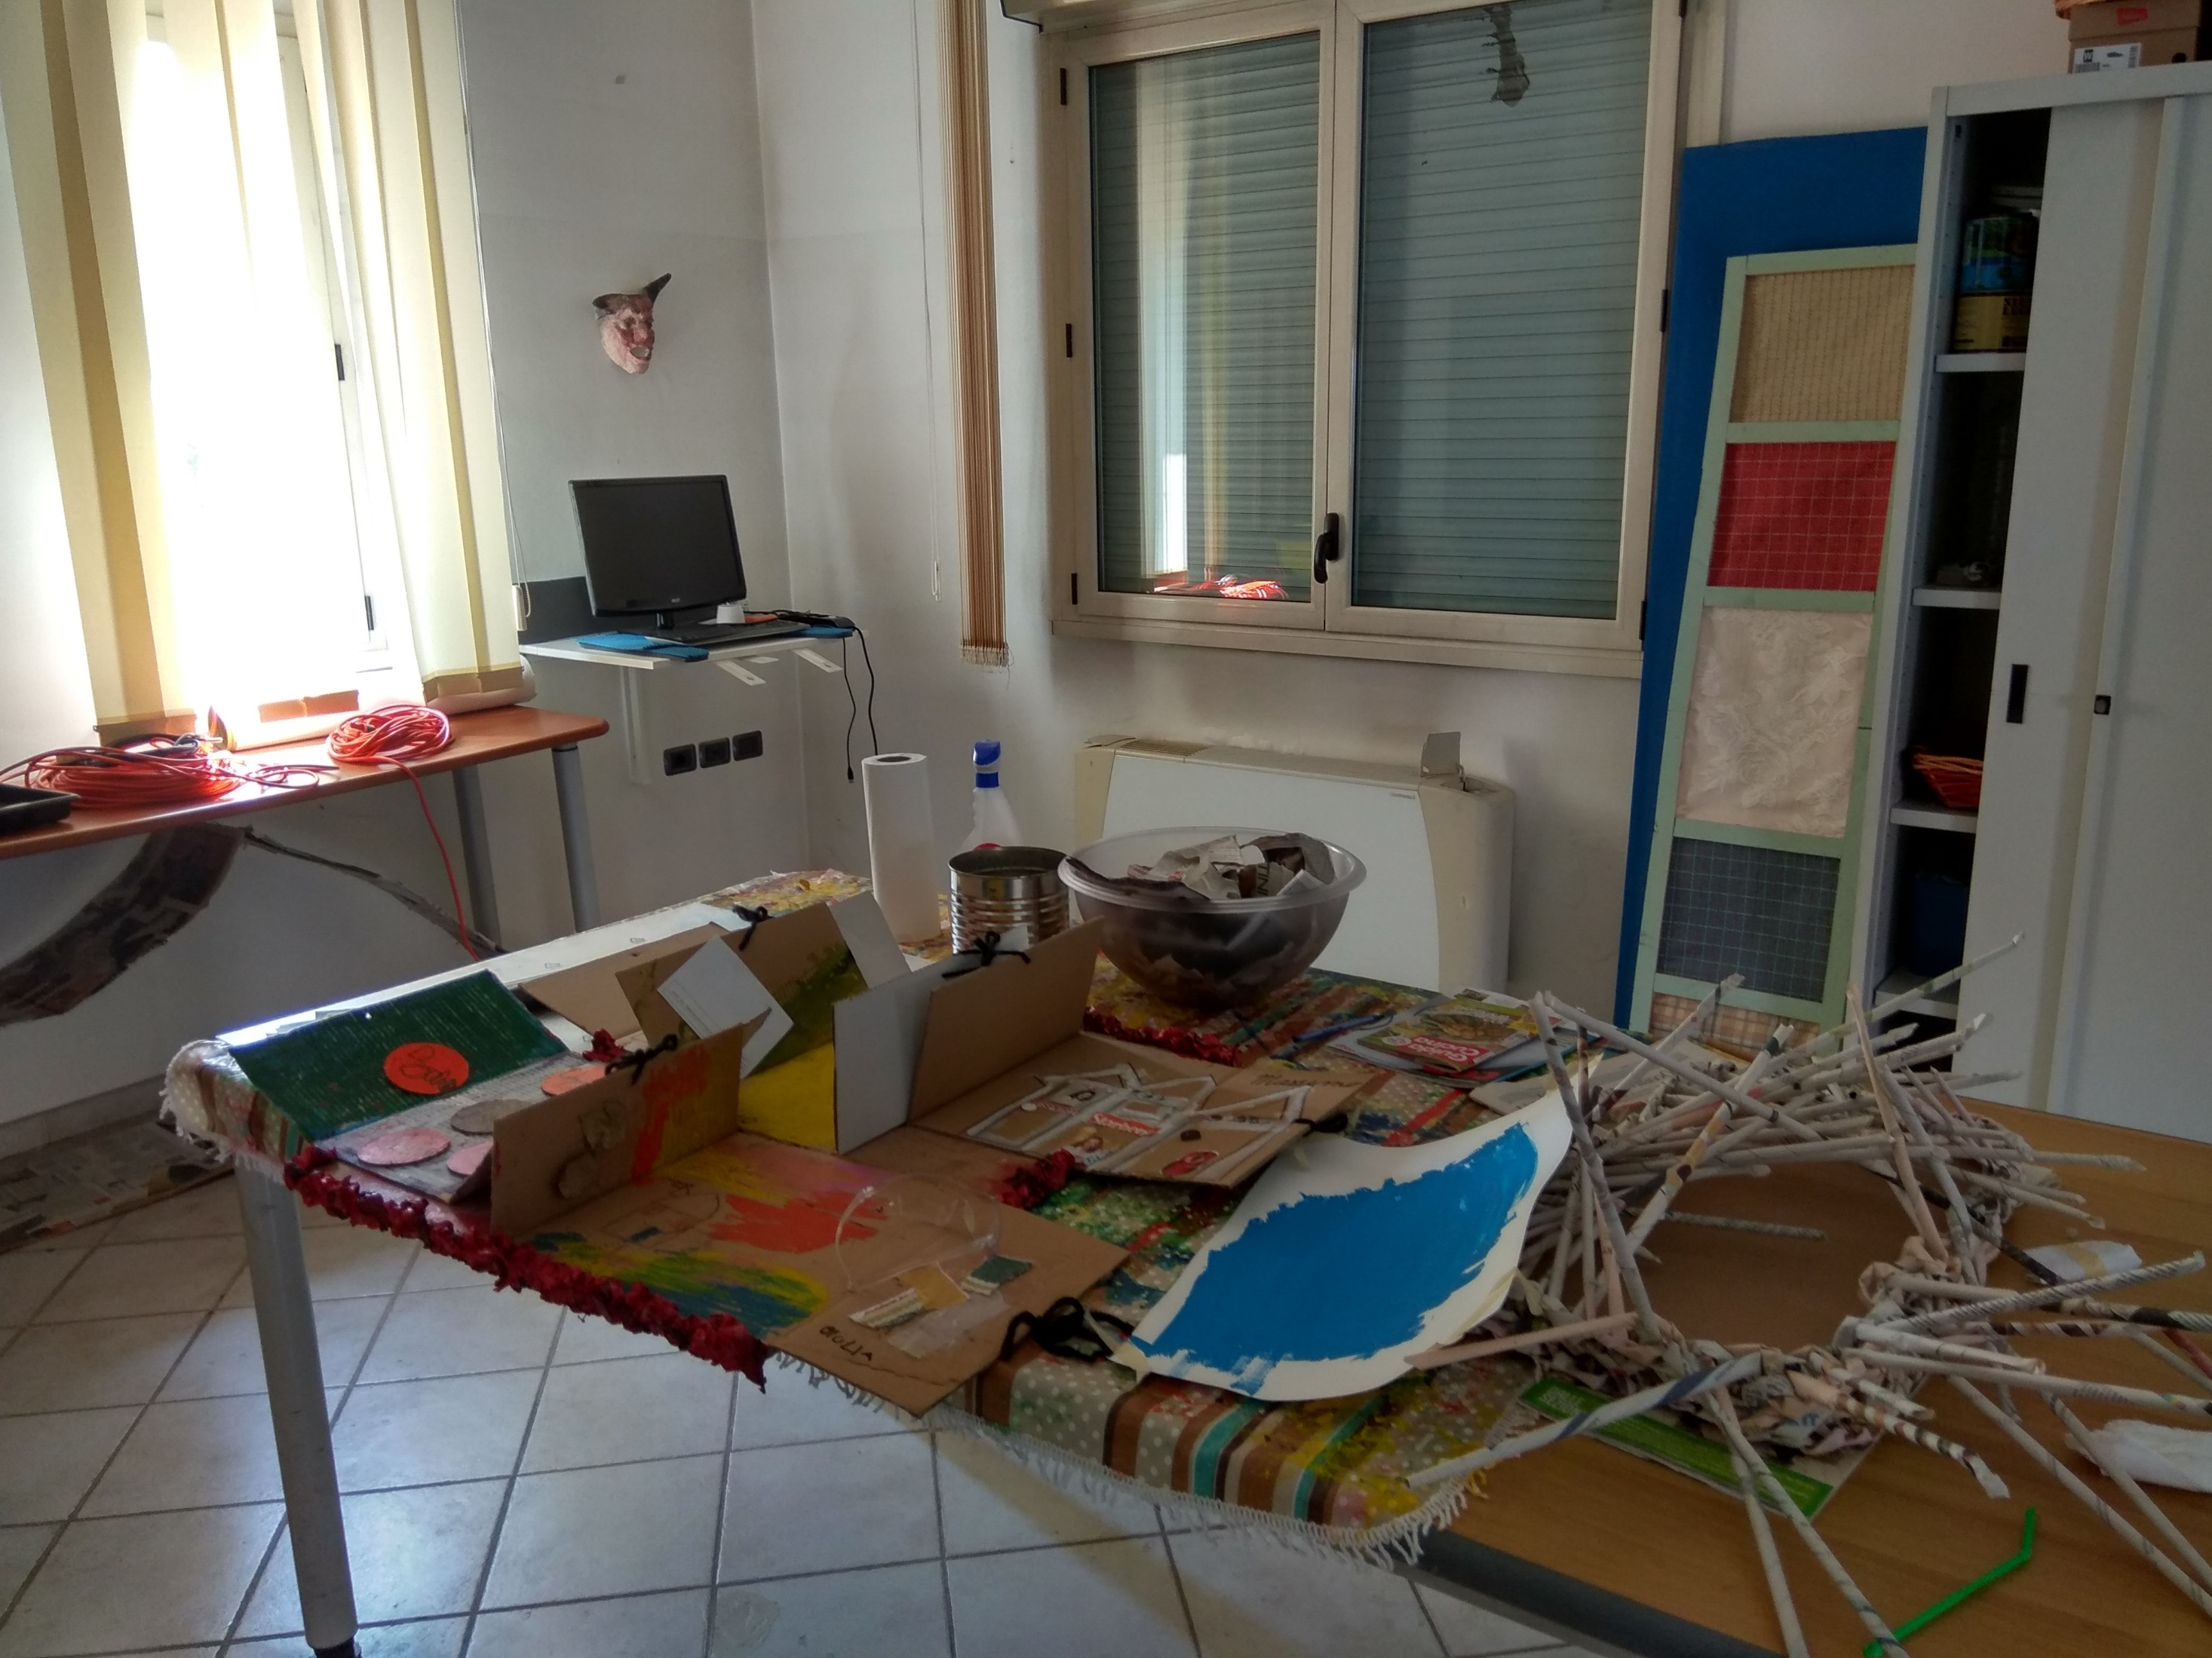
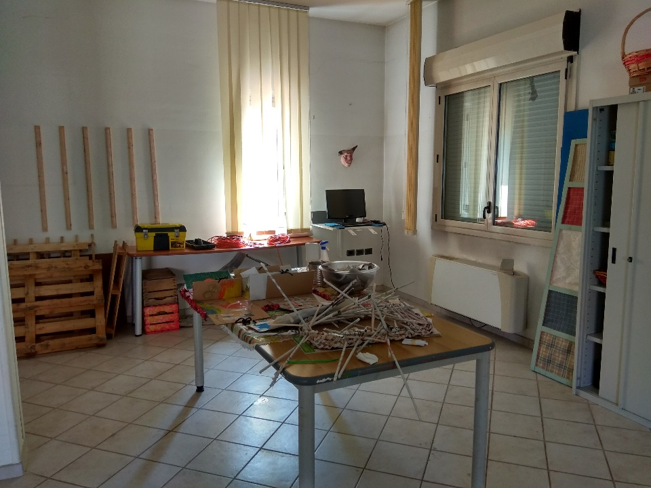
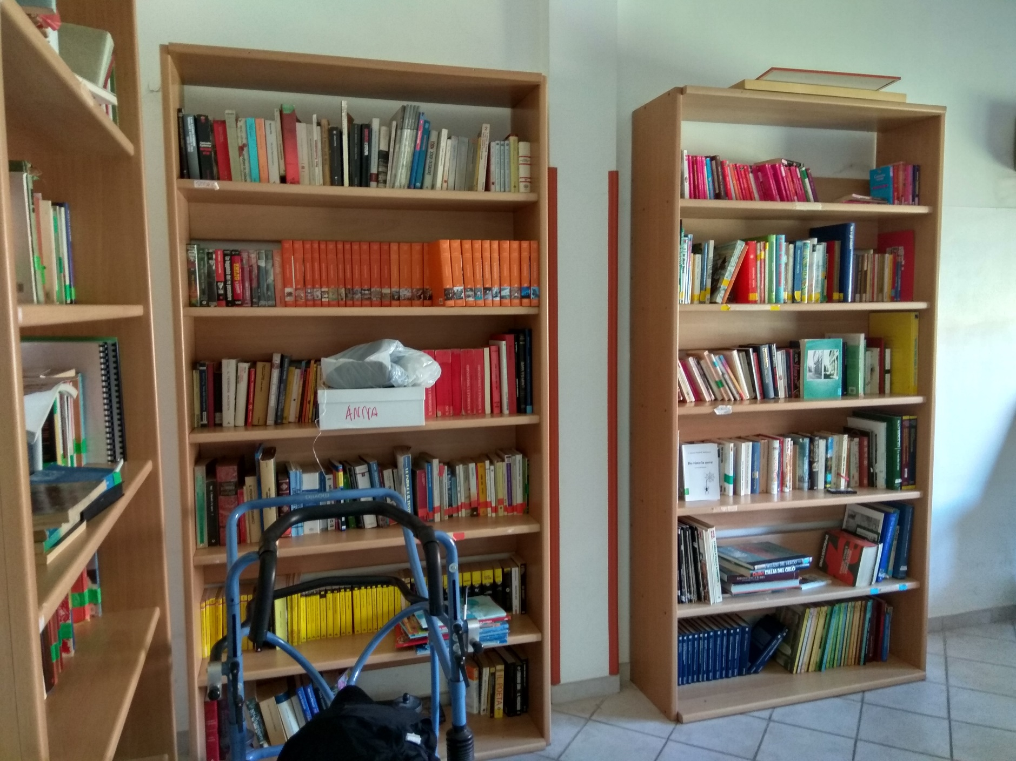
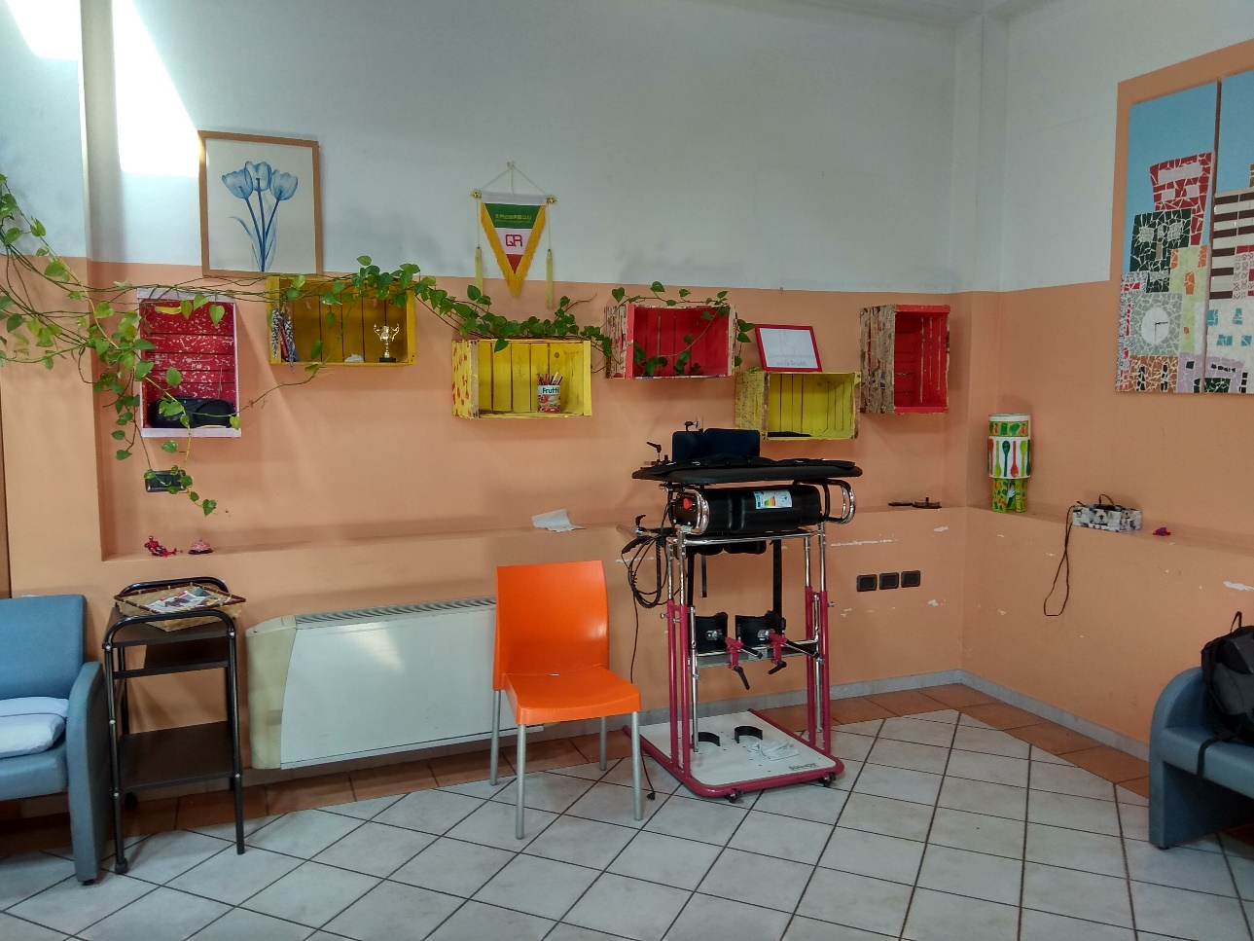
Other rooms…

Slide 23
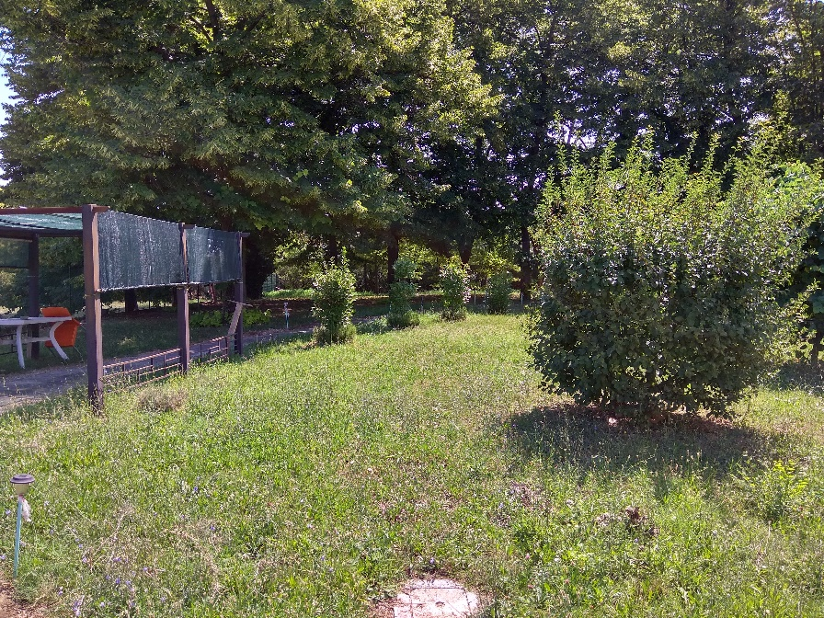
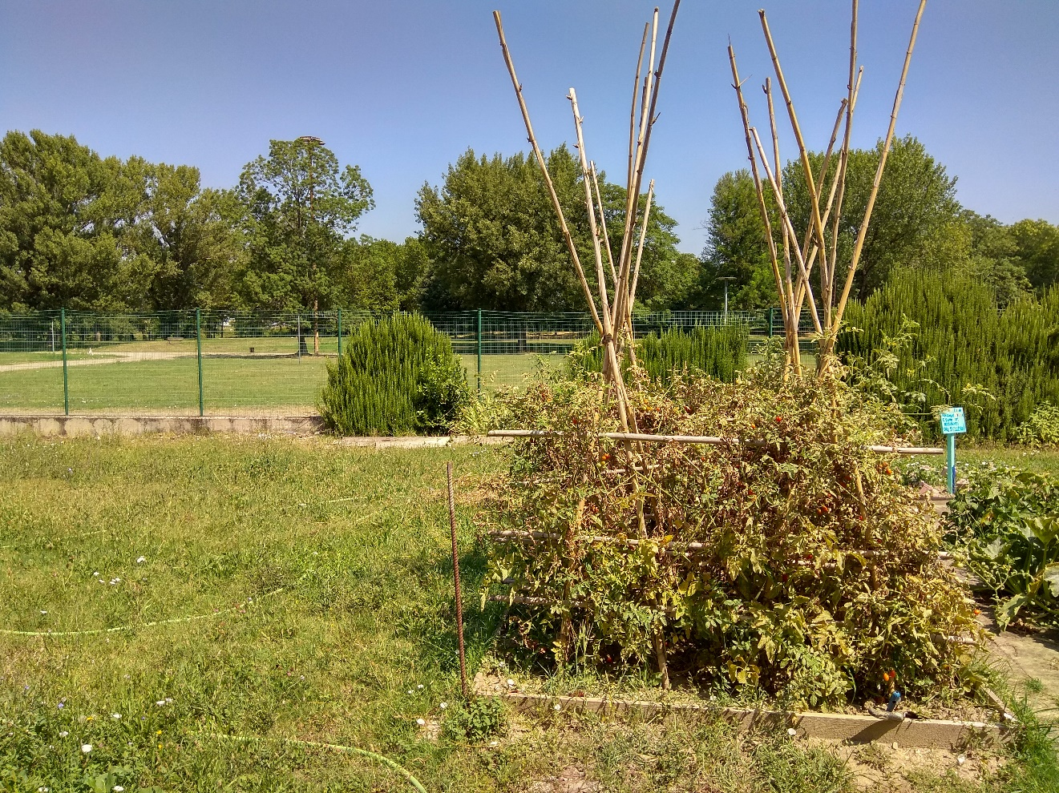
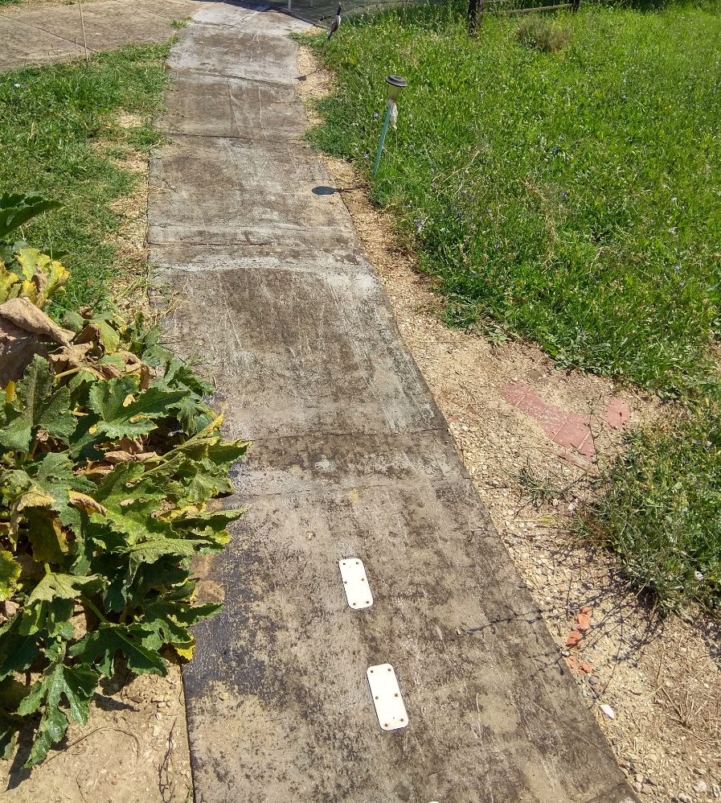
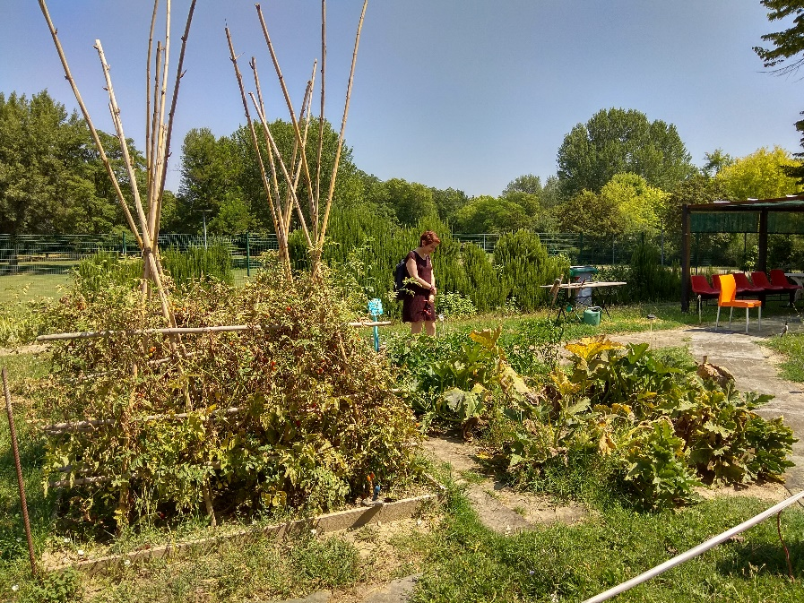
Outdoors

Slide 24
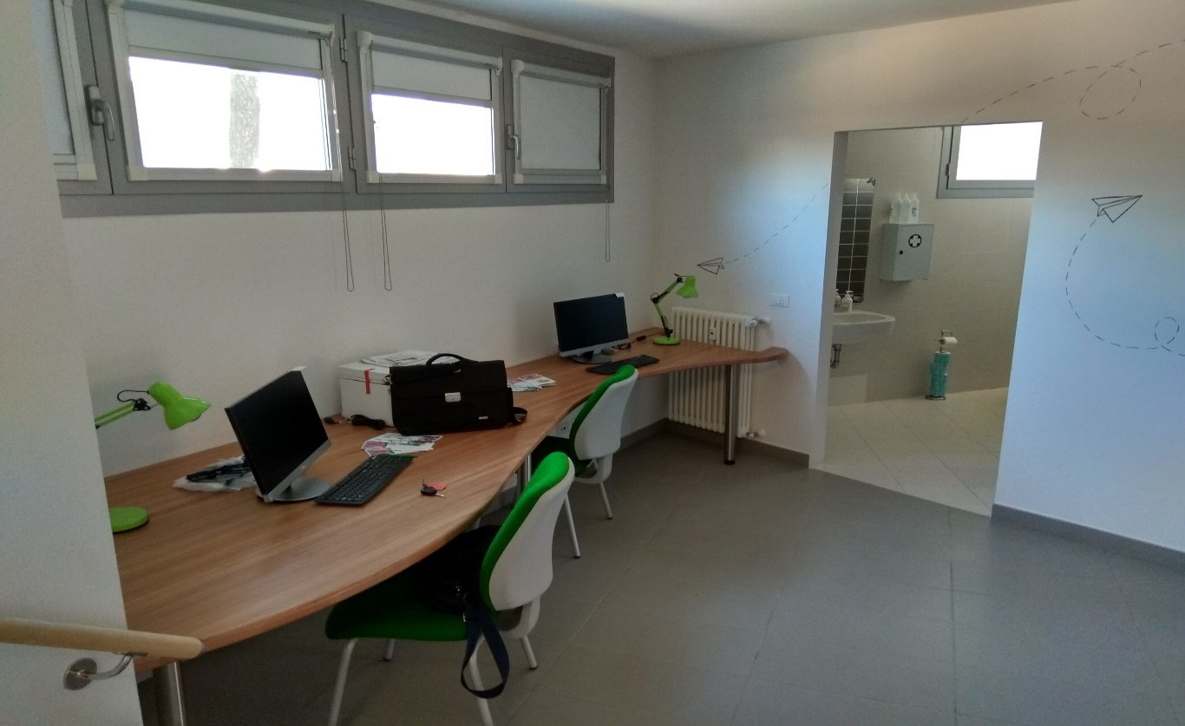
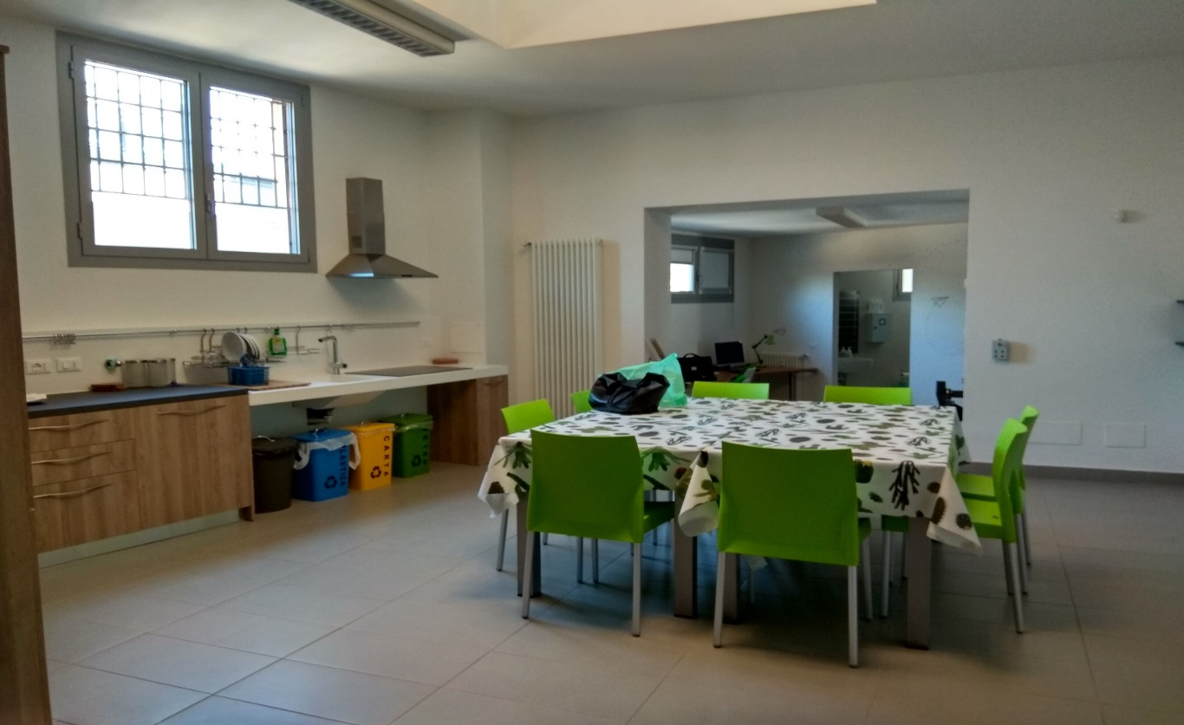
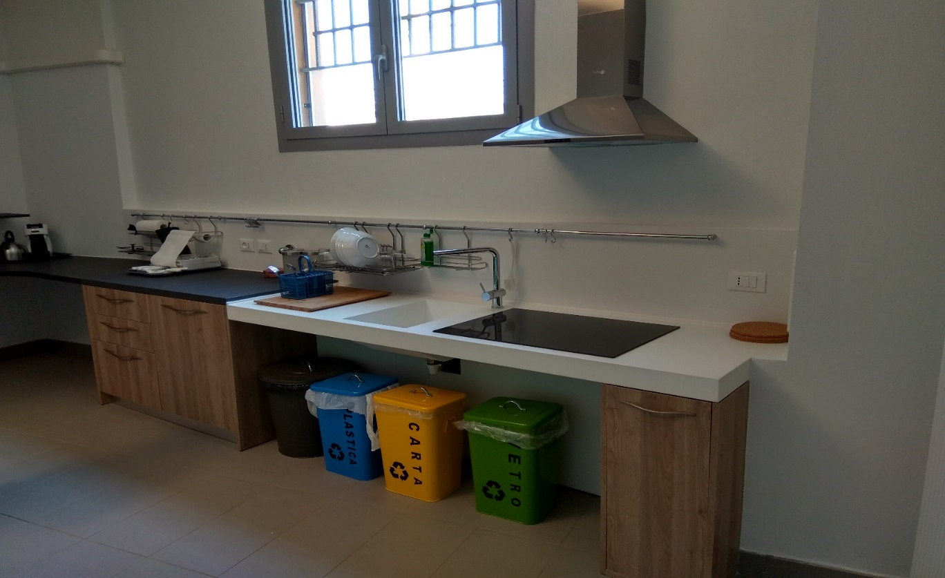
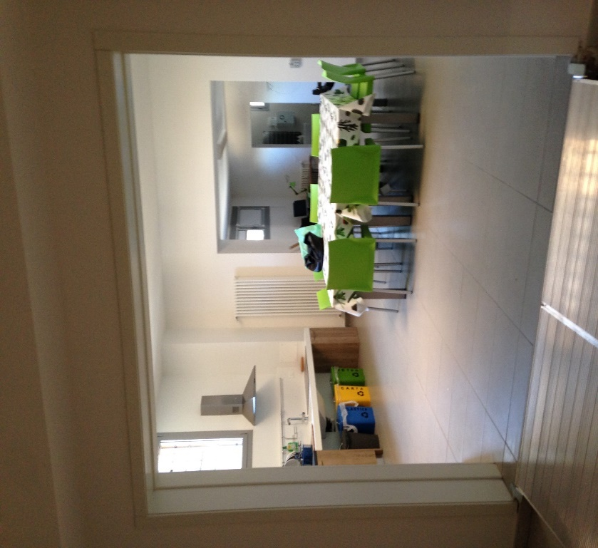
Visiting Co-housing L’OASI 27-7-2018
Communal areas

Slide 25
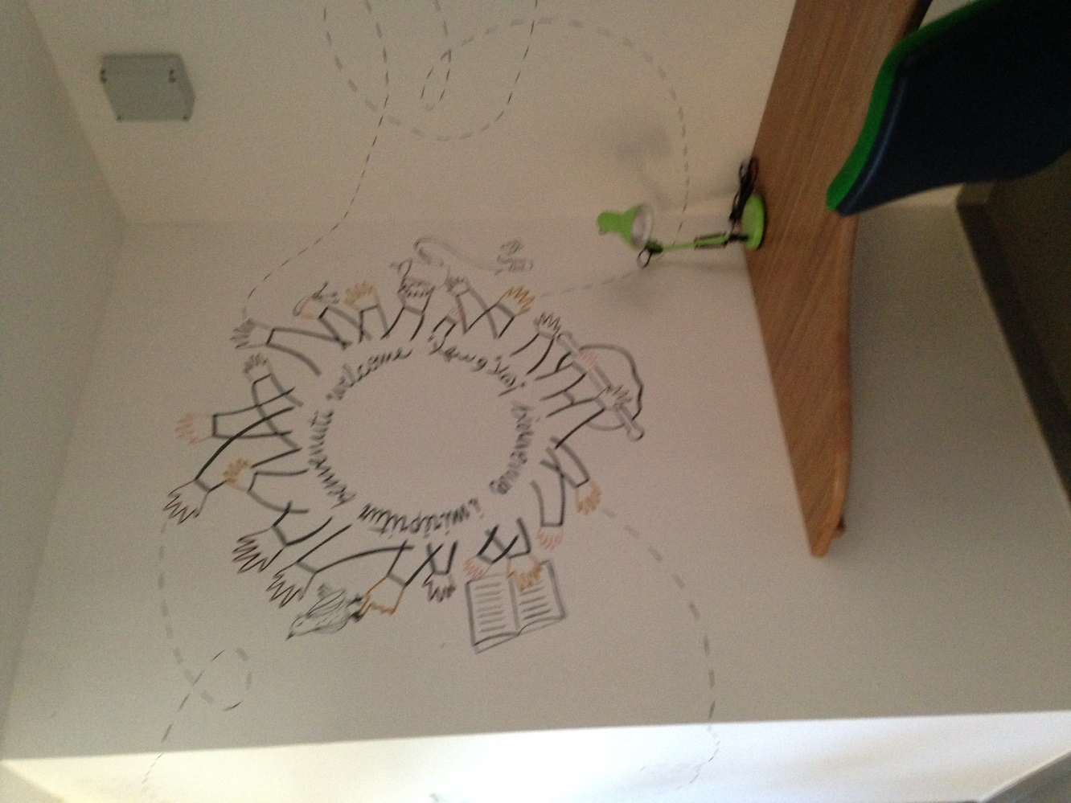
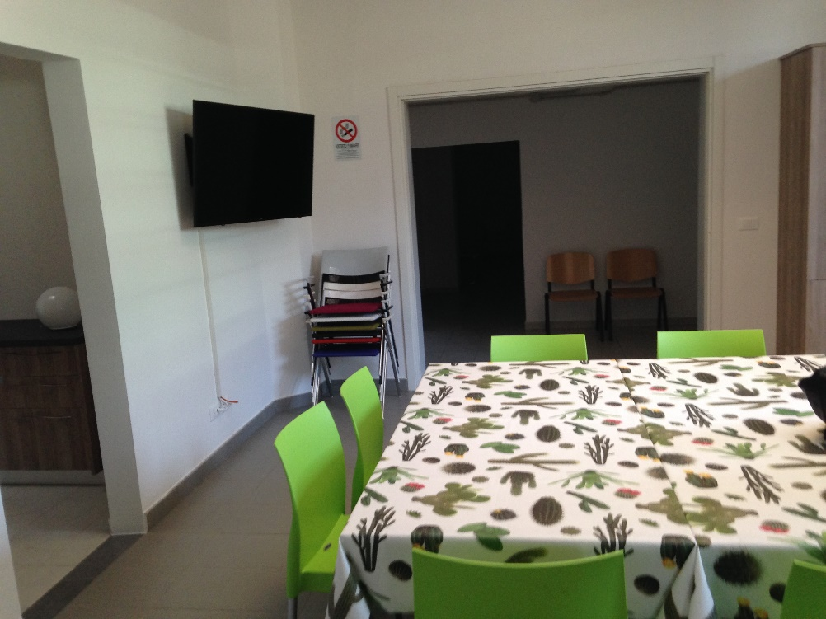
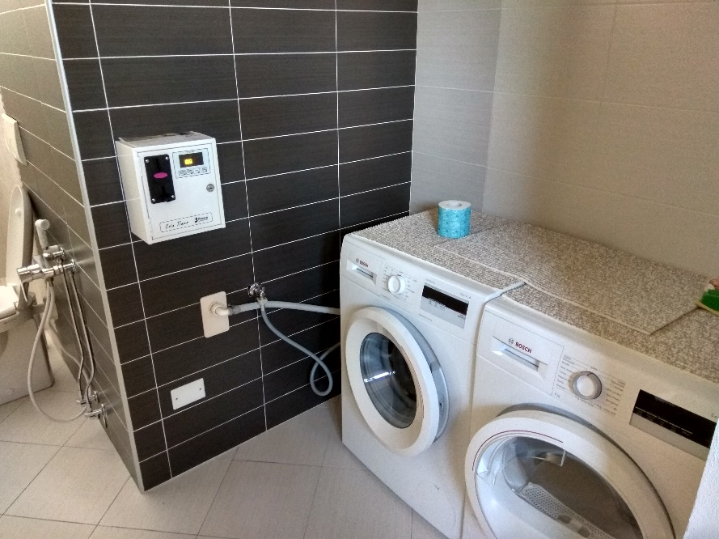

Shared Areas

Slide 26
¡Thank you for your time and hospitality! We hope to meet you in madrid

